Slide 1
OPTIFY™ Adjuvants
WinField United Local Campaign
ATLAS Materials

Slide 2
Topic: OPTIFY Adjuvants
SUBJECT LINE: Optimize the Potential of Your Tank Mix
COPY:
Invest in proven performance with OPTIFY adjuvants.
As you know, there’s no one-size-fits-all approach to crop protection. It’s important to find a tank-mix solution that works with your intended management style and helps meet your bottom line. If you’re searching for more convenience in your tank mix for next season, OPTIFY™ adjuvants might be just what you’re looking for.
Flexible adjuvants that fit your management style.
OPTIFY adjuvants are versatile, multifunctional blends that deliver convenient solutions to the most common tank mix problems. They’re designed to perform from a quality, efficacy and output standpoint to match the performance of other top tank-mix solutions.
Find the right solution for every acre.
Of course, we continue to offer WinField® United’s signature adjuvant lineup, which includes InterLock® adjuvant, MasterLock® adjuvant and Class Act® brands such as Class Act® NG® adjuvant — all unrivaled in the industry with excellent agronomics and outcomes. Ultimately, it’s about identifying the right product for the right acre.
Contact us today to learn more about OPTIFY adjuvants and to plan your crop protection strategy for next season.
Important: Before use always read and follow label instructions. Crop performance is dependent on several factors many of which are beyond the control of WinField United, including without limitation, soil type, pest pressures, agronomic practices, and weather conditions. Growers are encouraged to consider data from multiple locations, over multiple years, and be mindful of how such agronomic conditions could impact results.
©2020 WinField United. Class Act®, InterLock®, MasterLock®, NG®, OPTIFY™ and WinField® are trademarks of WinField United.

Slide 3
Topic: Additional Resources
Product pages:
o OPTIFY™ XX: https://www.winfieldunited.com/products/adjuvants/optify%e2%84%a2%20xx/741
o OPTIFY™ A20: https://www.winfieldunited.com/products/adjuvants/optify%e2%84%a2%20a20/739
o OPTIFY™ Z37: https://www.winfieldunited.com/products/adjuvants/optify%e2%84%a2%20z37/738
o OPTIFY™ L27: https://www.winfieldunited.com/products/adjuvants/optify%e2%84%a2%20l27/737
o OPTIFY™ D30: https://www.winfieldunited.com/products/adjuvants/optify%e2%84%a2%20d30/740
- Article, “Making the Case For Water Conditioners”: https://www.winfieldunited.com/news-and-insights/making-the-case-for-water-conditioners
Social Channel: Facebook or Twitter
OPTIFY™ adjuvants offer a simple, convenient tank-mix solution that fits your individual management style and needs. Contact us to find out more.
Link to [Local retailer website]

Slide 4
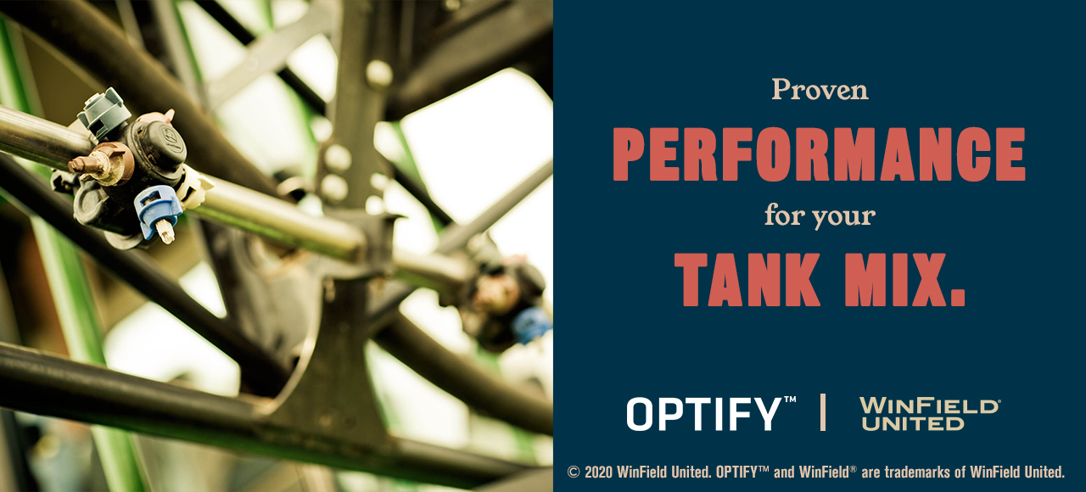
Email header

