Slide 1
Value of Harvest Data
WinField United Local Campaign
ATLAS Materials

Slide 2
Topic: Using Cover Crops
SUBJECT LINE: Make the Most of Your Harvest Data
COPY:
Use this season’s insights to shape next year’s management decisions.
With today’s technology, it can be easier than ever to collect data to help shape next season’s decisions. But even though all that data can be helpful, it can also be overwhelming to know where to start. Here are some tips to help find the most value from this year’s yield data.
Understand what your data can offer. Talk with your agronomist about how to best interpret, analyze and use this year’s data from your combine and from any technology tools you used. Identifying the highest- and lowest-producing parts of your field and assessing the results of any on-farm trials you conducted are just some of the ways you can optimize the data you’ve collected.
Build on last year’s data. When making next year’s plan, don’t forget to include any data you or your agronomist have from previous years to calculate notable changes and determine why fields did better than or not as well as projected.
Validate your harvest results with proven data. We can help you fuse your numbers with data from any trials we conducted at our retail location along with data from the WinField® United® Answer Plot® program to create a holistic snapshot of 2020.
Contact us today for help in analyzing this season’s data and using it to make decisions for 2021.
Important: Before use always read and follow label instructions. Crop performance is dependent on several factors many of which are beyond the control of WinField United, including without limitation, soil type, pest pressures, agronomic practices, and weather conditions. Growers are encouraged to consider data from multiple locations, over multiple years, and be mindful of how such agronomic conditions could impact results.
©2020 WinField United. Answer Plot® and WinField® are trademarks of WinField United.

Slide 3
Topic: Additional Resources
Article: “Leverage Harvest Data to Drive Next Season’s Crop Decisions”: https://www.winfieldunited.com/news-and-insights/leverage-harvest-data-to-drive-next-season-s-crop-decisions
Article: “Tips for Capturing and Using Harvest Data”: https://www.winfieldunited.com/news-and-insights/tips-for-capturing-and-using-harvest-data
The Deal With Yield podcast episode: “Don’t Just Collect Harvest Data; Use It”: https://www.winfieldunited.com/news-and-insights/don-t-just-collect-harvest-data-use-it-episode-113
Social Channel: Facebook or Twitter
Post 1:
Using quality harvest data can help you accurately assess the growing season just past and effectively plan for the year ahead. Contact us to help you analyze seed and crop protection data from your fields and use it to make key decisions.
Link to [Local retailer website]
Post 2:
Harvest data can be a useful tool in choosing seed and crop protection products for next season, provided it’s accurate and collected correctly. Use these five tips to help find value in your harvest data.
Link to: https://www.winfieldunited.com/news-and-insights/leverage-harvest-data-to-drive-next-season-s-crop-decisions

Slide 4
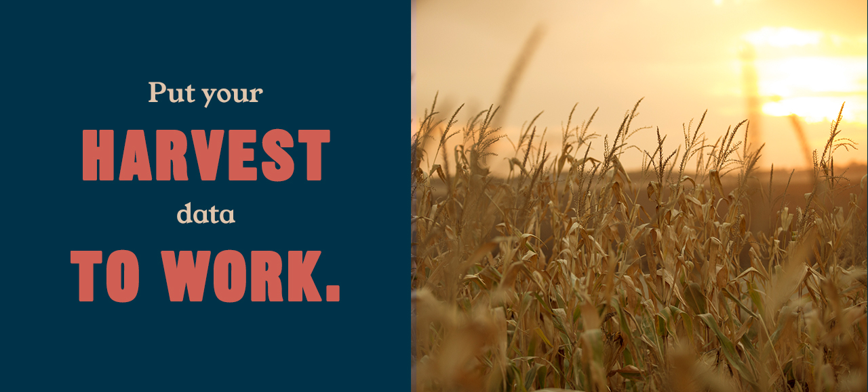
Email header

